Slide 1
Outcome: Nights

Slide 2
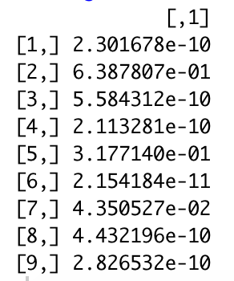
By Date Booked – No Ridge Regression
Average ATT Estimate (Std. Error): -304.460 (27.743)
Chicago
Montreal
Quebec City

Slide 3
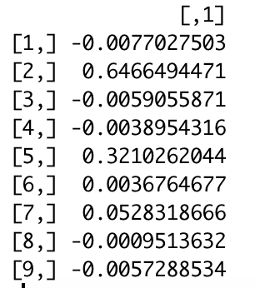
By Date Booked – Ridge Regression
Average ATT Estimate (Std. Error): -308.604 (64.53)
Chicago
Montreal
Quebec City
Results and weights are similar across different values of lambda

Slide 4
By Reservation Date – 3 timescales (no ridge)
Week
Bimonth (14 days)
Month
Ridge results similar, without setting lambda too large

Slide 5
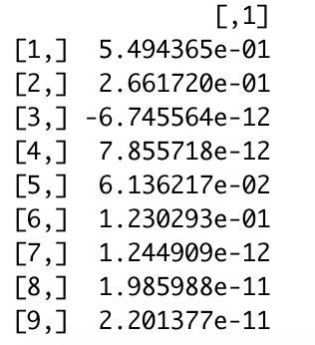
By Reservation Date – Semi-monthly
Average ATT Estimate (Std. Error): -2150.269 (1123.228)
Asheville
Chicago
Nashville

Slide 6
Outcome: Price

Slide 7
By Date Booked – No Effect

Slide 8
By Reservation Date – borderline statistically significant
Bimonth (14 days)
Month
Ridge results similar, without setting lambda too large

Slide 9
Outcome: Nights + Price

Slide 10
By Date Booked – Effects generally consistent

Slide 11
By Reservation Date – Effects consistent

Slide 12
Outcome: Entries/Exits

Slide 13
Entries/Exits – No Statistical Effect
Entries
Exits

